Slide 1
“TO-DO PLANNER
WEBSITE”
Task - 1

Slide 2


TO DO PLANNER WEBSITE
A simple to do list website to manage your tasks, projects, and team's work. ... Tasks & lists; Reminders; Calendar; Daily Planner. Tasks & lists. Reminders.
LMS Username | Name | Batch
2113a52199 | SANJAY U | A52
2113a52181 | KEVIN RICHARD L | A52

Slide 3

Task - 1
Creation of SRS & Github
Create SRS : “TO DO PLANNER WEBSITE”
Creation & Set-up of Github account
Creation & Hands-on to various commands of Git Bash
Evaluation Metric:
100% Completion of the above tasks
Learning Outcome
Get to know about different lifecycle models.
Understanding importance and how to create an SRS
Knowing various commands of Github
Understanding agile and scrum management techniques for efficient product development

Slide 4
SRS for “TO DO PLANNER WEBSITE "
FUNCTIONAL REQUIREMENTS
Task Creation
Task Management
Reminder System
Collaboration Features
Analytics
Reporting

Slide 5
SRS for “TO DO PLANNER WEBSITE "
NON FUNCTIONAL REQUIREMENTS
Social media integration
Entertainment content
E-commerce features
Health monitoring
Communication tools

Slide 6
SRS for “ TO DO PLANNER WEBSITE "
SOFTWARE REQUIREMENTS
Programming Language - JAVA
Web Server Apache
Database - MYSQL
Content Management System –WordPress
Search Engine
CDN
App Development Framework

Slide 7
SRS for “TO DO PLANNER WEBSITE "
HARDWARE REQUIREMENTS
i3 Processor Based Computer
1 GB RAM
50 GB Hard Disk
Monitor
Internet Connection

Slide 8
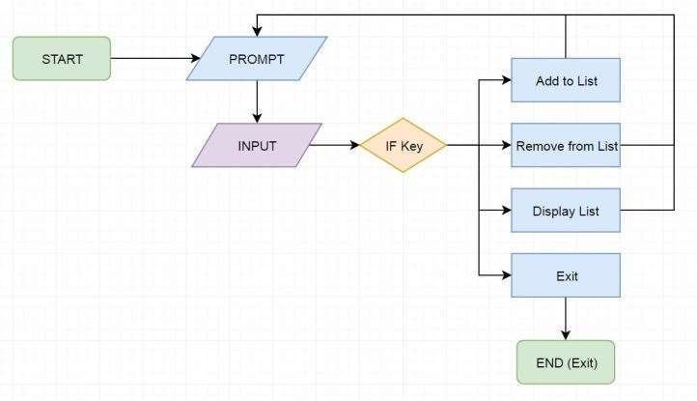
FLOW CHART TO DO PLANNER WEBSITE

Slide 9
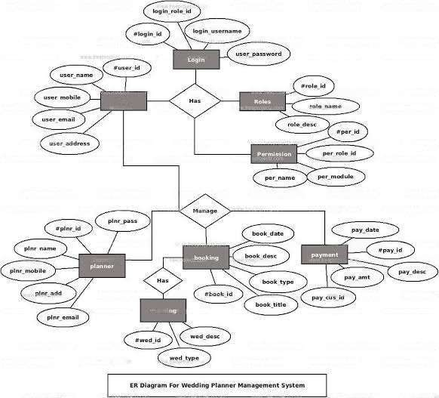
ER DIAGRAM

Slide 10
Step-Wise Description
Initial Requirements Collection
Start of DB structure
Start of Front End Development
End of DB structure
Completion of Front End
Start of Back End
Complete entire app
Test of App
Deployment
Summary of your task
Each task is scheduled among the members of the team according to their interest

Slide 11


Assessment Parameter
Gather requirements for the
project
add Readme.md file with description of the project
Prepare database design
schemas
Check-List
Commit all changes with "first commit"
Get your initial project
Structure ready
create a repository on github
realted to project
Initiate a git repository
Push your changes to github

Slide 12


Submission Github
https://github.com.Sanjayu2020
/Naan-mudhalvan-fsd

Slide 13


